Slide 1
Sprint 2
Music Trivia Web-based Game

Slide 2
Contents
What I did?
What’s next?

Slide 3
What I did?
Wireframe
Setup backend and frontend environment
CRUD functionalities backend
Create UML class diagram for user

Slide 4
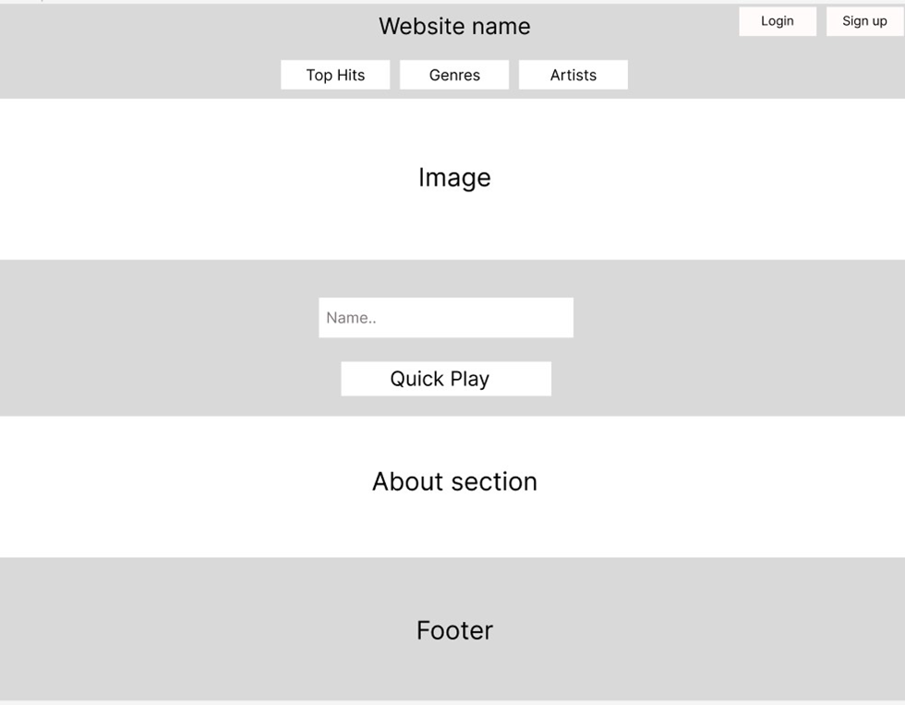
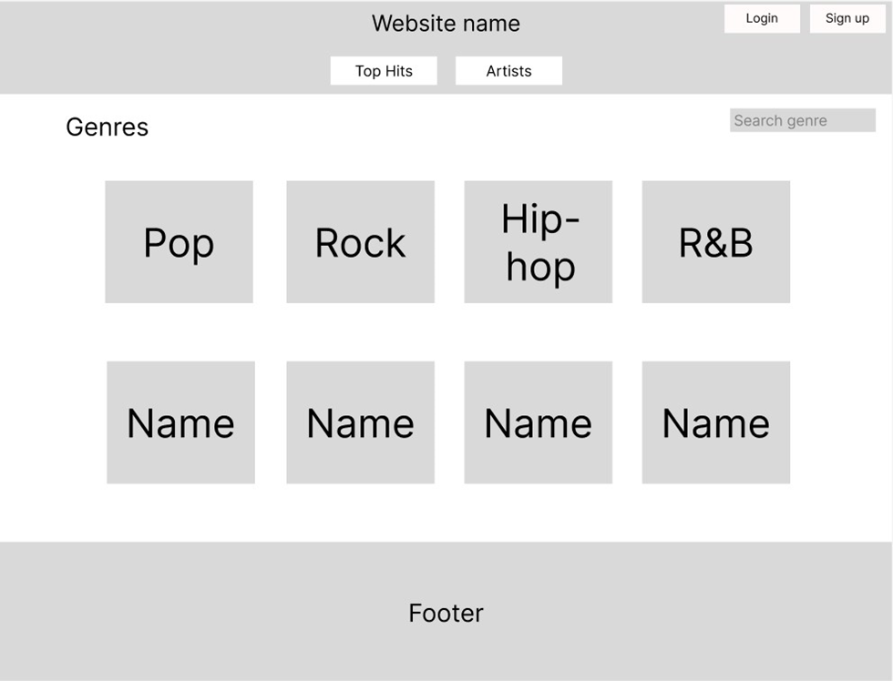
Wireframe

Slide 5
CRUD functionalities backend

Slide 6
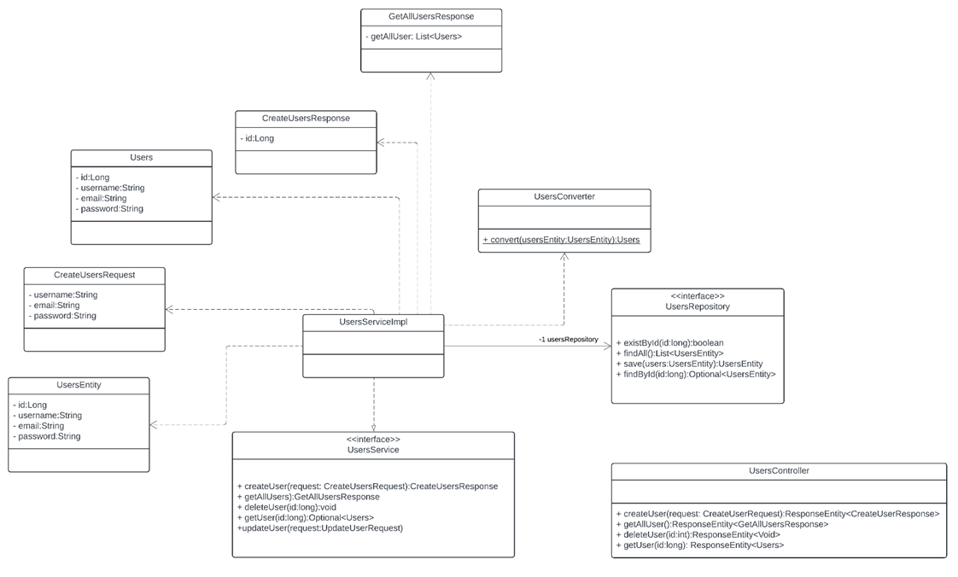
Create UML class diagram for user

Slide 7
What’s next
Create test plan.
Create unit tests.
Setup CI/CD.
Implement authentication and authorization.
Do research question 1 and 2.

Slide 8

Thank you

